Slide 1
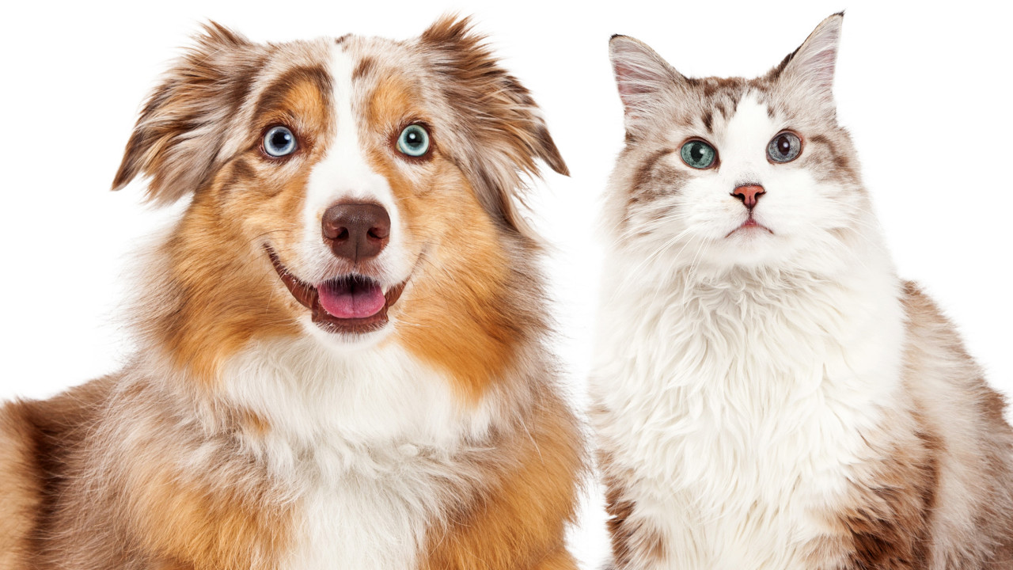
Image Classification
Amanda Tavares
Arina Sanches
Lirielly Nascimento

Slide 2
Agenda
Experiments
Dataset Analysis
Data Augmentation
VGG-16 Architecture
EficientNet B7 Architecture
Available pre-trained weights models in Keras
Execution Results
Reinforcement Learning
RL - Execution Results
Bibliography

Slide 3
Experiments
VGG1
VGG2
VGG3
Dropout
Data Augmentation
Transfer Learning
VGG16
EfficientNetB7
Steps followed
2 classes: dogs and cats
2 classes with data augmentation: dogs and cats
3 classes: dogs, cats and butterfly

Slide 4
Dataset analysis

Slide 5
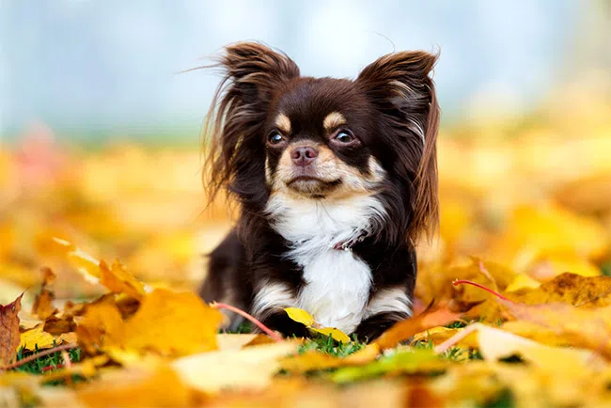

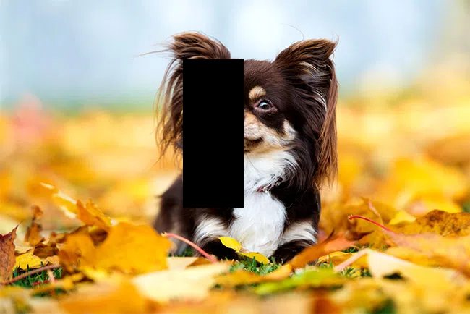
Data Augmentation
original image
gaussian white noise
blocking mask
+ 1000 for cats + 1000 for dogs
+ 2000 for cats + 2000 for dogs

Slide 6
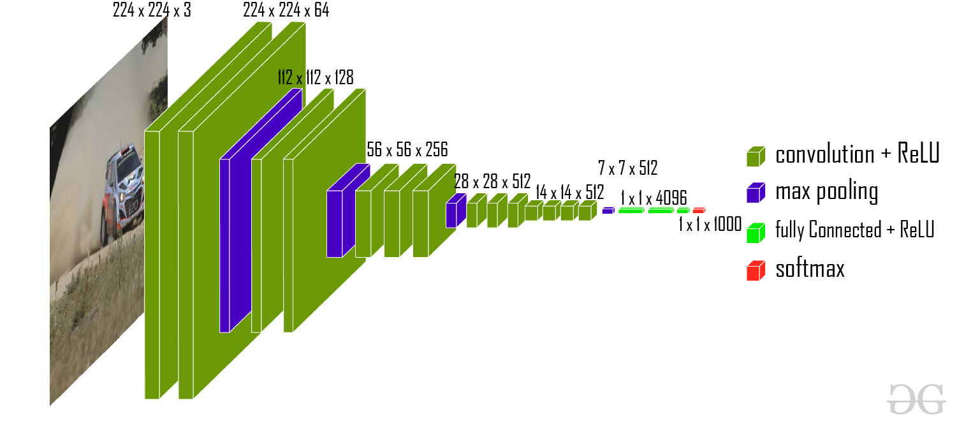
VGG-16* Architecture
*depth: 16 weighted layers

Slide 7
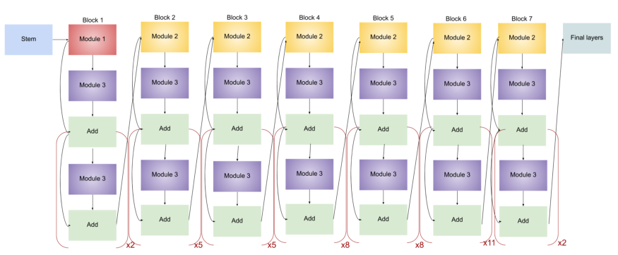
EfficientNet B7* Architecture
*depth: 438 weighted layers

Slide 8
Available pre-trained weights models in Keras

Slide 9
Execution Results

Slide 10
Reinforcement Learning

Slide 11
RL - Execution Results

Slide 12
Bibliography
How to Classify Photos of Dogs and Cats
Keras Applications
Complete Architectural Details of all EfficientNet Models
VGG-16 | MODELO CNN
Using deep q-learning in the classification of an imbalanced dataset

